Slide 1
Latent variable models
for the analysis of heterogeneous information
Marco Lorenzi
Epione Research Group, Université Côte d’Azur, Inria
Notes:
Good morning.
Before to start I would like to thank the organizers for inviting me for this talk

Slide 2
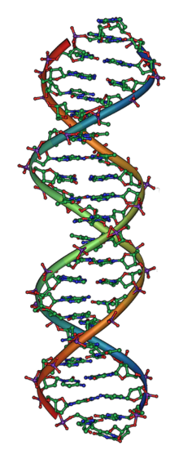
Variability of multivariate biomedical data
- within/between views -
Introduction
Signal
Relationship
Causal
biology
Mediated
bias field (scanner)
Spurious
noise
processing bias
(e.g. imputation)
Must be Inferred
Calhoun and Adali, IEEE Trans Inf Technol Biomed. 2009; Meda et al, NeuroImage 2010; Vonou et al, NeuroImage 2010; Groves et al, NeuroImage 2011; Sui et al; NeuroImage, 2013; Miller et al, Nat Neurosci, 2016; Li Shen and Paul Thompson, Proc of the IEEE, 2019; …
Notes:
The second aspect concerns the ability to establish a link between very different observations and data, characterized by specific properties and biases.
This is important for obtaining a comprehensive model of the pathology.

Slide 3


Variability of multivariate biomedical data
- between datasets -
Population
Acquisition
Processing
Data security
…
Calhoun and Adali, IEEE Trans Inf Technol Biomed. 2009; Meda et al, NeuroImage 2010; Vonou et al, NeuroImage 2010; Groves et al, NeuroImage 2011; Sui et al; NeuroImage, 2013; Miller et al, Nat Neurosci, 2016; Li Shen and Paul Thompson, Proc of the IEEE, 2019; …

Slide 4
Latent variable models
1. Multi-variate modeling
2. Novel scalable approaches to multi-view data
Notes:
It is within this context that I develop my research project, especially the most recent one, that I will illustrate in this talk.

Slide 5
Latent variable models
1. Multi-variate modeling
2. Novel scalable approaches to multi-view data
Notes:
It is within this context that I develop my research project, especially the most recent one, that I will illustrate in this talk.

Slide 6
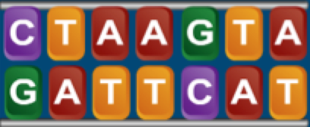
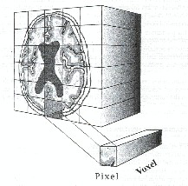
…
…

Slide 7
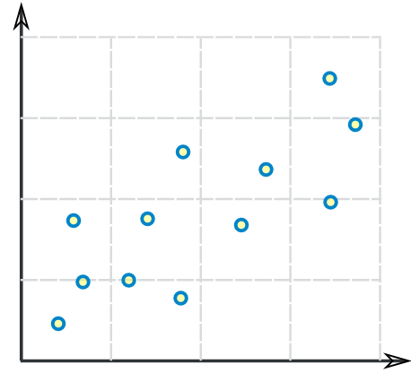
…
…

Slide 8
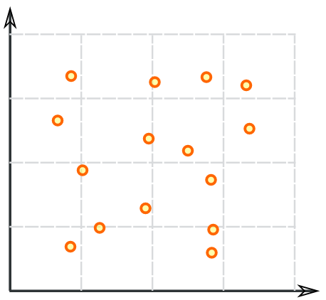
…
…

Slide 9
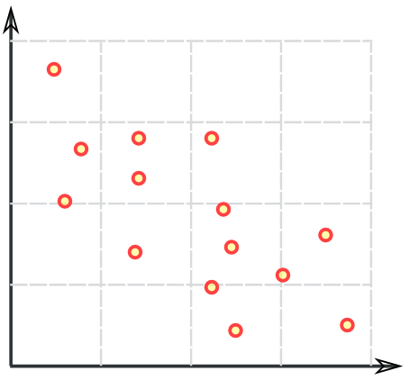
…
…

Slide 10
…
…

Slide 11
…
…
Iterate for > 1’000’000 variants

Slide 12
…
…
Iterate for > 1’000’000 variants
Iterate for > 1’000’000
image locations

Slide 13

…
…
Iterate for > 1’000’000 variants
Iterate for > 1’000’000
image locations
Hard interpretability
False positive discoveries
No interaction across brain and genetic areas

Slide 14
A unified statistical formulation via
latent generative models
bias,
noise,
confounding factors,
…
f
z
g
The inference problem
parameters
data

Slide 15
The building-block: linear model
Y
X
w
ε
=
.
+

Slide 16
The building-block: linear model
Y
X
w
ε
=
.
+

Slide 17
Classical formulation of latent variable models
X
w_{X}^{T}
ε_{X}
=
+
X
w_{X}^{T}
z
z
inference
Y
w_{Y}^{T}
w_{Y}^{T}
Y
ε_{Y}
=
+
z
Geladi and Kowalski, Analytica Chimica Acta, 1985

Slide 18
Formalization of latent variable models
X
w_{X}^{T}
Y
w_{Y}^{T}
ε_{X}
ε_{Y}
=
+
=
+
t_{X}
t_{Y}
X
Y
Goal:
Identifying
Projections (loadings) w
Latent representation (scores) t
w_{X}
w_{Y}
w_{X}^{T}
w_{Y}^{T}
t_{X}
t_{Y}
Geladi and Kowalski, Analytica Chimica Acta, 1985

Slide 19
Formalization of latent variable models
X
d_{X}
Y
d_{Y}
N
N
1
1
t_{X}
t_{Y}
N
N
w_{X}^{T}
d_{X}
w_{Y}^{T}
d_{Y}
1
1

Slide 20
Formalization of latent variable models
X
d_{X}
Y
d_{Y}
N
N
1
1
Cov(X w_{X} , Y w_{Y})
1
1
X w_{X}
Y w_{Y}
t_{X}
t_{Y}
N
N
N
N
||w_{X}|| = 1
||w_{Y}|| = 1
w_{X}^{T}
d_{X}
w_{Y}^{T}
d_{Y}
1
1

Slide 21
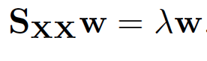
Principal Components Analysis (case X=Y)
A variance maximisation problem:

Slide 22
Non-linear iterative partial least squares - NIPALS Wold 1975
Why it works:
Then
eigen-solution of the covariance matrix X ^{T} X
X
w
w^{T}
t_{X}
Geladi and Kowalski, Analytica Chimica Acta, 1985

Slide 23
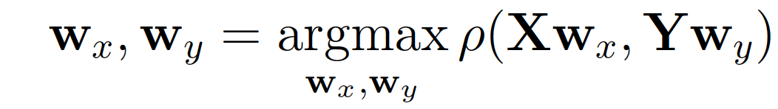
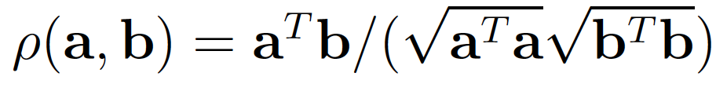
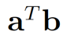
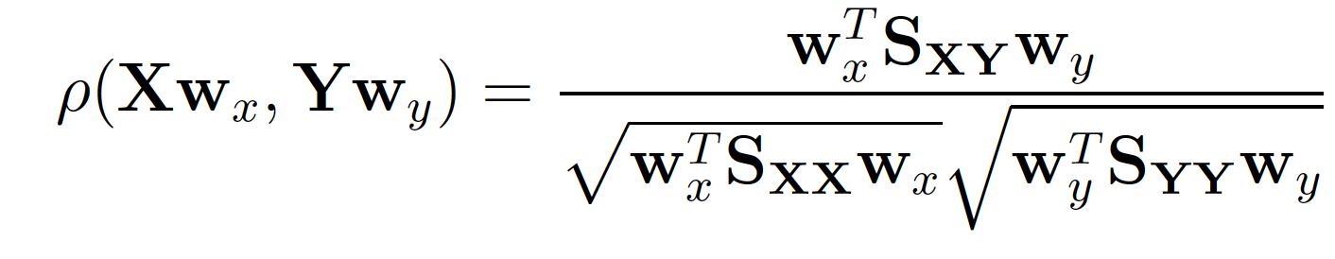
Canonical Correlation Analysis
A correlation maximisation problem:
ϕ

Slide 24
Canonical Correlation Analysis
A correlation maximisation problem:
ϕ
Cross-covariance
Within-modality covariance

Slide 25
Canonical Correlation Analysis

Slide 26
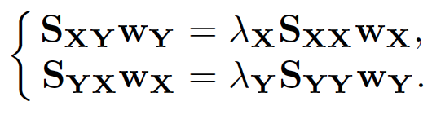
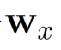
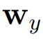
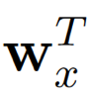
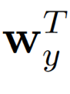
Canonical Correlation Analysis

Slide 27
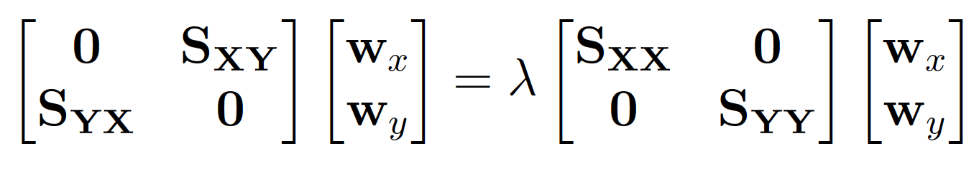
Canonical Correlation Analysis
CCA is solved as a generalized eigenvalue problem

Slide 28
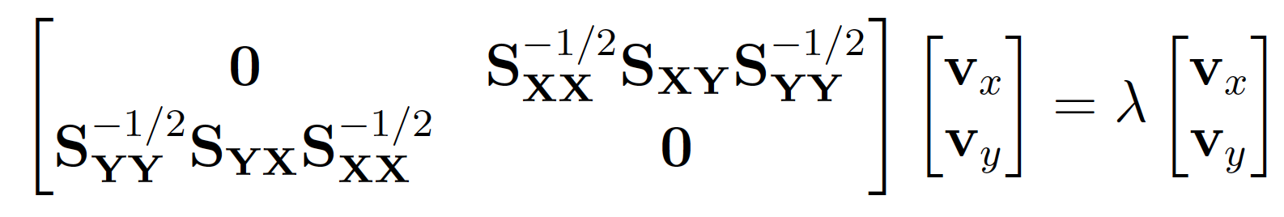
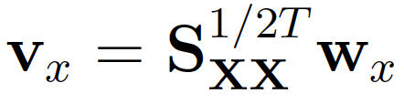
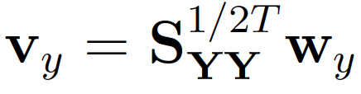
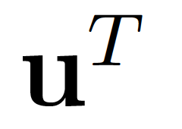
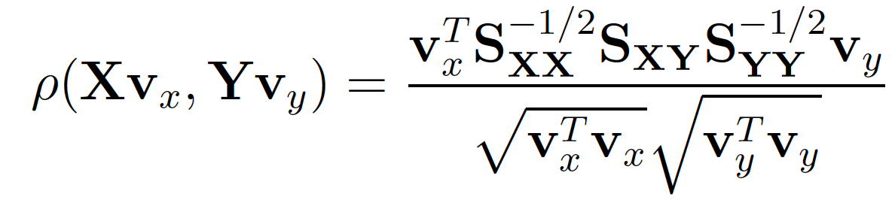
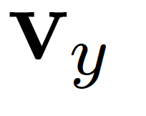
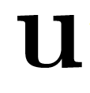
Canonical Correlation Analysis (alternative formula)
The quantity is maximized when parallel to

Slide 29
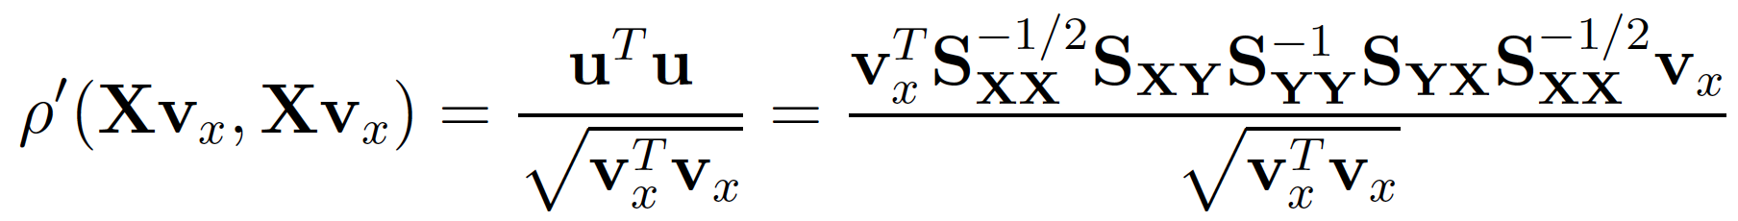
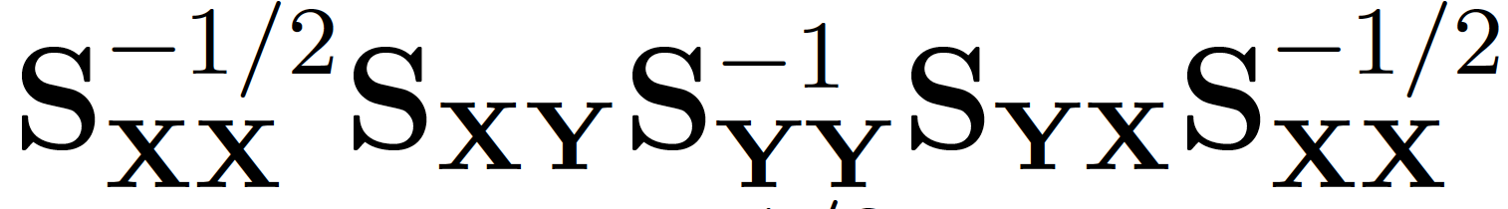
Canonical Correlation Analysis (alternative formula)
Eigen-solution for the matrix

Slide 30
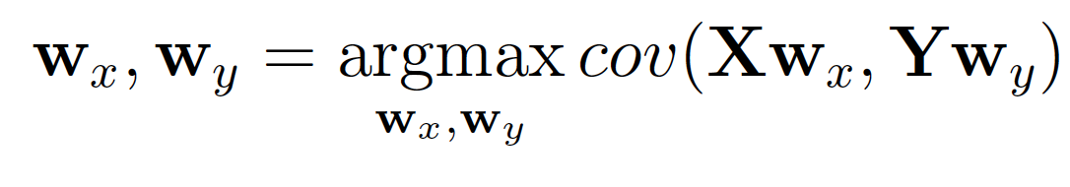
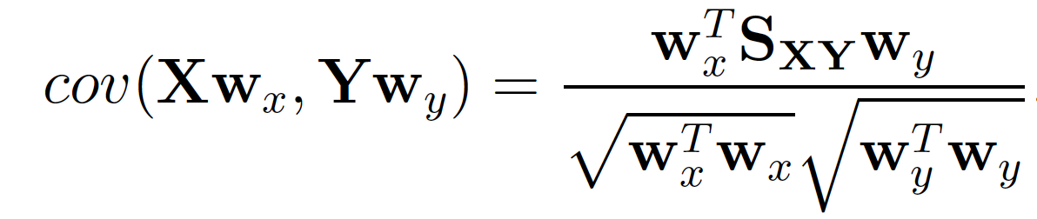
Partial Least Squares
A co-variance maximisation problem:

Slide 31
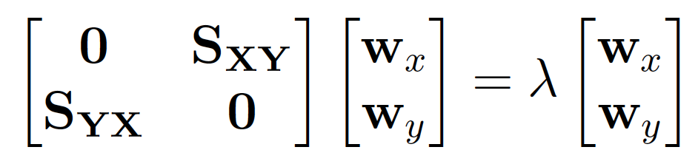
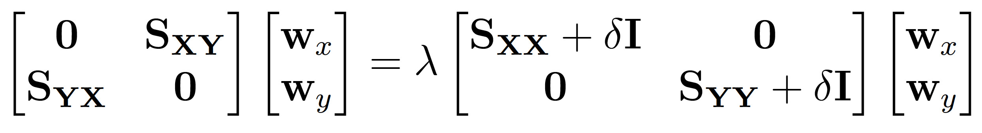
Partial Least Squares
The PLS problem is solved via singular value decomposition (SVD) of the covariance matrix S_{XY}
PLS and regularized CCA
δ ∞
PLS

Slide 32
Non-linear iterative partial least squares - NIPALS
scikit-learn/sklearn/cross_decomposition
X
Y
w_{X}
w_{Y}
w_{X}^{T}
w_{Y}^{T}
t_{X}
t_{Y}
left eigen-solution of X^{T} Y
Geladi and Kowalski, Analytica Chimica Acta, 1985

Slide 33
Non-linear iterative partial least squares - NIPALS
scikit-learn/sklearn/cross_decomposition
X
Y
w_{X}
w_{Y}
w_{X}^{T}
w_{Y}^{T}
t_{X}
t_{Y}
Geladi and Kowalski, Analytica Chimica Acta, 1985

Slide 34
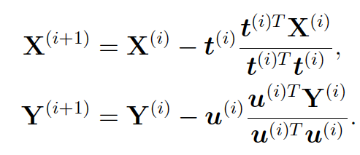
Non-linear iterative partial least squares - NIPALS Deflation
Iterate until
residual component negligible epsilon
Difference between consecutive residual components negligible
Geladi and Kowalski, Analytica Chimica Acta, 1985

Slide 35
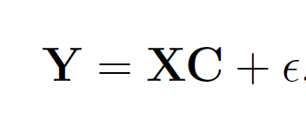
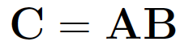
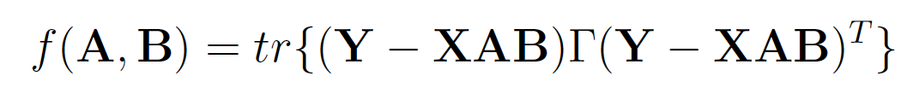
Reduced Rank Regression
Y
X
A
B
.
ε_{Y}
=
+

Slide 36
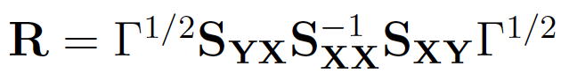
Reduced Rank Regression
Solution associated to the eigen-decomposition of the matrix
Matrix encoding prior knowledge on Y

Slide 37
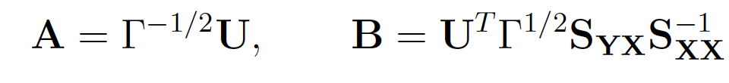
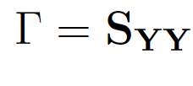
Reduced Rank Regression
Solution associated to the eigen-decomposition of the matrix
Matrix encoding prior knowledge on Y
RRR solutions:
Special case:
CCA

Slide 38
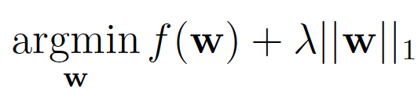
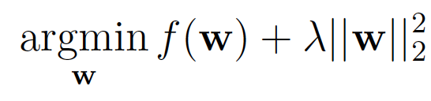
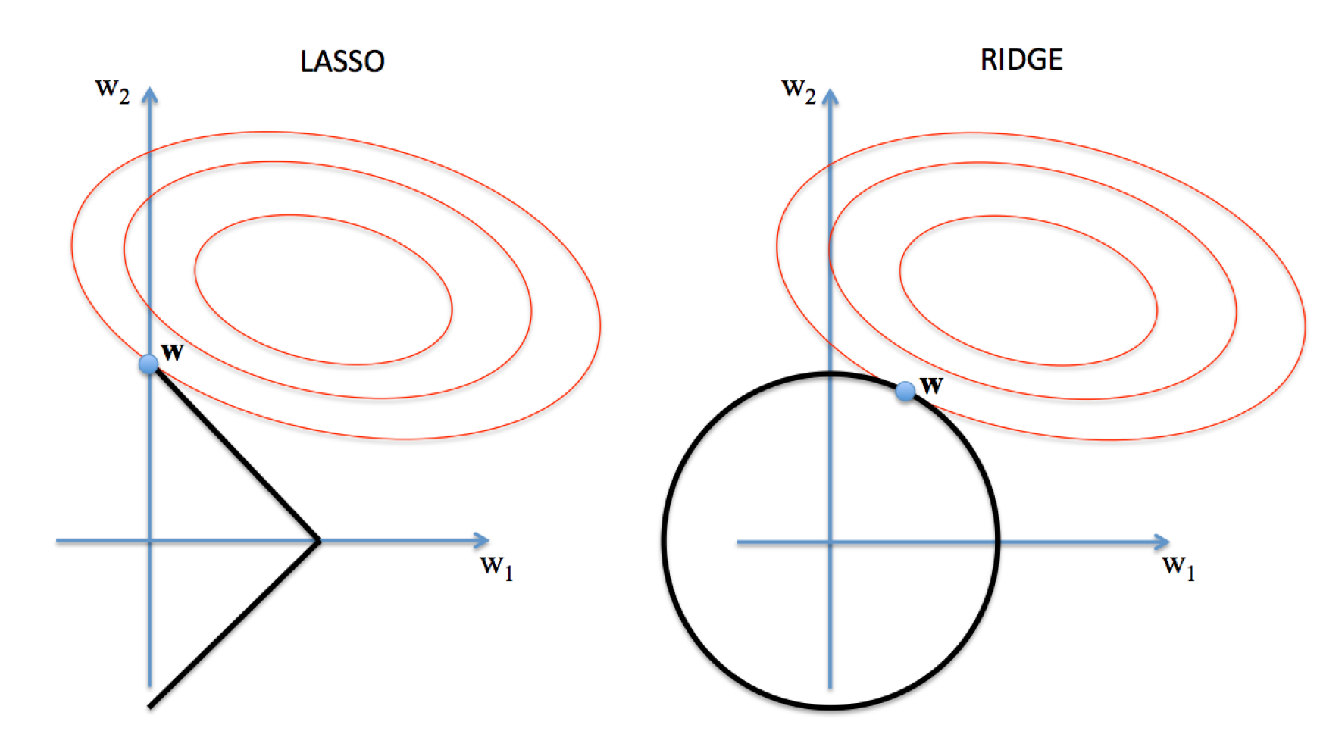
Sparsity in latent variable models

Slide 39
Worked example: Ridge linear regression
Shrinkage parameter towards zero solutions

Slide 40
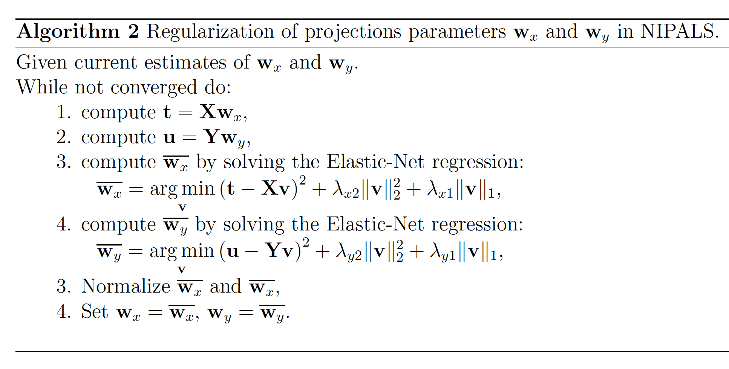
S. Waaijenborg, A. H. Zwinderman, Penalized canonical correlation analysis to quantify the association
between gene expression and dna markers, in: BMC proceedings, Vol. 1, BioMed Central, 2007

Slide 41
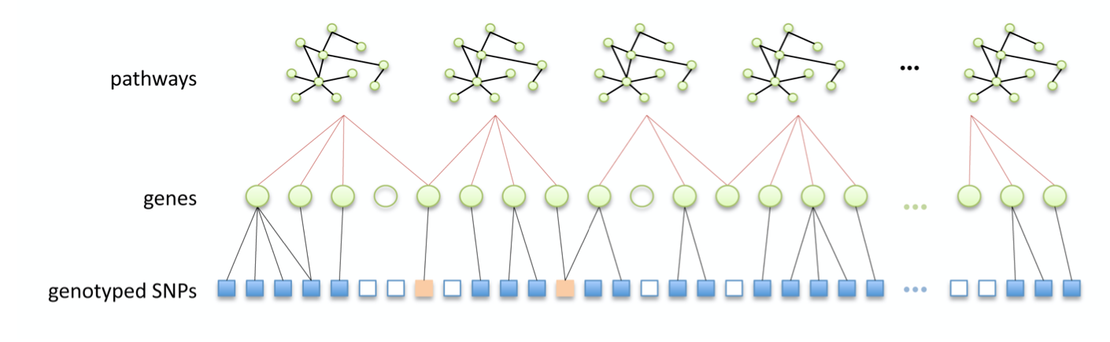
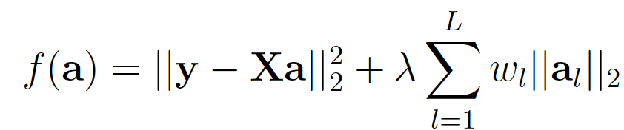
Group-wise penalization
Vonou et al, NeuroImage 2010; Silver et al, NeuroImage, 2012; Zhu et al, 2017; …

Slide 42
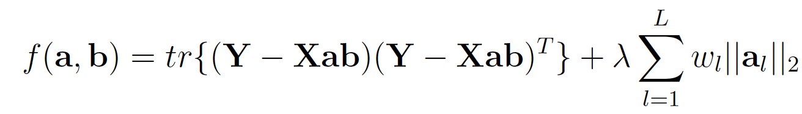
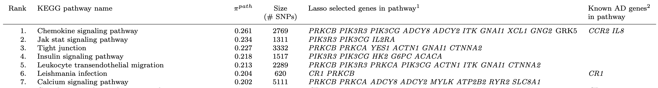
Group-wise penalization
Reduced-rank regression proposed by Silver et al, 2012:
Imaging features
genetic data
Mapping from genetics to latent space

Slide 43
An example of PLS in imaging-genetics

Slide 44
Multivariate Association studies
Introduction
Maximizing the joint relationship between genetic variants and brain features
~10⁶ SNPs
Partial least squares (PLS)
max_{p,q} Cov( X . p, Y . q )
X =
N individuals
~10⁵ brain features
Y =
N individuals
Liu et al, Front in Neuroinformatics, 2014; Silver et al, NeuroImage 2012; Szymczak et al, Genetic Epidemiology 2009; …
Notes:
An optimal approach for dealing with this massive amount of information is represented by multivariate statistical
In standard approaches, such as partial least squares, we encode imaging and genetic data as large arrays, and we aim at finding a transformation of the data, for example a linear projection, to maximise their relationship.

Slide 45
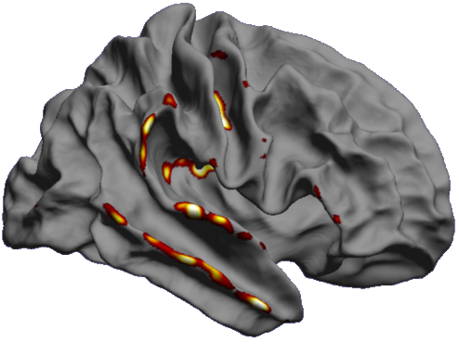
Multivariate Association studies
Introduction
Maximizing the joint relationship between genetic variants and brain features
~10⁶ SNPs
Partial least squares (PLS)
max_{p,q} Cov( X . p, Y . q )
X =
N individuals
~10⁵ brain features
PLS weights
=
relative importance
Y =
N individuals
chromosome N
Liu et al, Front in Neuroinformatics, 2014; Silver et al, NeuroImage 2012; Szymczak et al, Genetic Epidemiology 2009; …
Notes:
Multivariate models overcome issues of standard mass univariate approaches, as they don’t suffer of multiple comparison problems, thus can be more sensitive, and explore SNP-SNP interactions.
However we must take care of overfitting issues, and they can be computationally overwhelming

Slide 46
Multivariate Association studies
Introduction
Maximizing the joint relationship between genetic variants and brain features
~10⁶ SNPs
Partial least squares (PLS)
max_{p,q} Cov( X . p, Y . q )
X =
N individuals
~10⁵ brain features
PLS weights
=
relative importance
Y =
N individuals
chromosome N
Pros. Overcomes issues of mass univariate analysis
Avoiding independent multiple testing
Exploring SNP-SNP interaction (epistatic effects)
Cons.
Overfitting and reproducibility
Computational complexity
Liu et al, Front in Neuroinformatics, 2014; Silver et al, NeuroImage 2012; Szymczak et al, Genetic Epidemiology 2009; …
Notes:
Multivariate models overcome issues of standard mass univariate approaches, as they don’t suffer of multiple comparison problems, thus can be more sensitive, and explore SNP-SNP interactions.
However we must take care of overfitting issues, and they can be computationally overwhelming

Slide 47
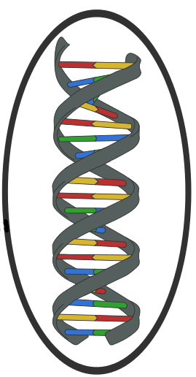
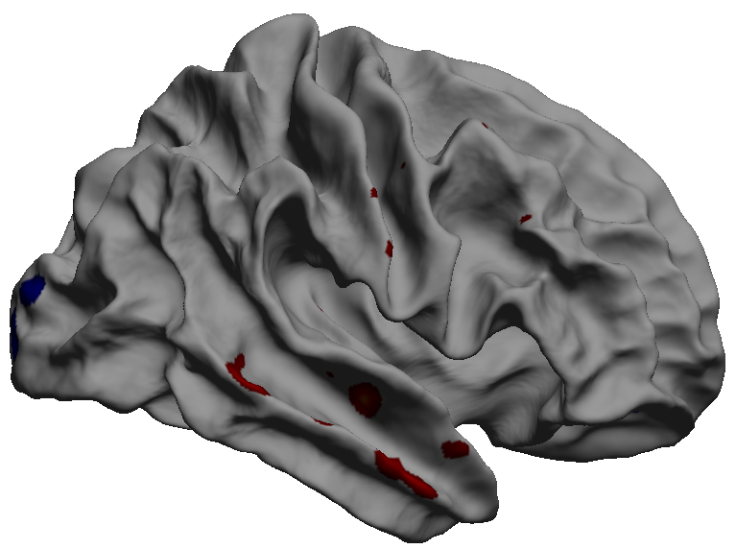
Stability assessment
Random partitioning of the population in non-overlapping groups (split-half)
Imaging genetic
Notes:
The stability of the model was ensured through a split-half cross validation setting.
The population was partitioned in two non-overlapping cohorts

Slide 48
Stability assessment
Random partitioning of the population in non-overlapping groups (split-half)
Extraction of PLS components
PLS
PLS
PLS weights associated to individual SNPs
PLS weights associated to individual SNPs
Partitioning of chromosomes (bin size: 10k )
Notes:
and two independent PLS models were fitted

Slide 49
Stability assessment
Random partitioning of the population in non-overlapping groups (split-half)
Imaging genetic
Extraction of PLS components
PLS
PLS
PLS weights associated to individual SNPs
PLS weights associated to individual SNPs
Top 5%
Partitioning of chromosomes (bin size: 10k )
Notes:
We identified the relevant genetic locations associated to the maximal weights

Slide 50
Stability assessment
PLS
PLS
Identification of relevant loci
(binarization)
1
0
1
0
1
0
1
0
0
1
0
1
0
1
1
0
0
0
Notes:
and we labelled them

Slide 51
Stability assessment
PLS
PLS
1
1
1
1
1
1
0
1
0
1
Stable estimator of relevant loci
(AND)
0
1
1
.
Notes:
We then averaged the independent results to obtain a stable estimated

Slide 52
Stability assessment
10⁶
iterations
PLS
PLS
1
1
1
1
1
1
0
1
0
1
Stable estimator of relevant loci
(AND)
0
1
1
.
Notes:
The whole procedure was repeat 1 million times to compute the probability of relevant locations

Slide 53
Stability assessment
10⁶
iterations
PLS
PLS
Same procedure for the assessment of brain thickness component at each mesh point
1
0
1
0
1
0
1
0
0
1
0
1
0
0
1
0
1
0
Stable estimator of relevant loci
(AND)
0
1
1
.
Notes:
The same procedure was applied to identify the relevant brain areas

Slide 54




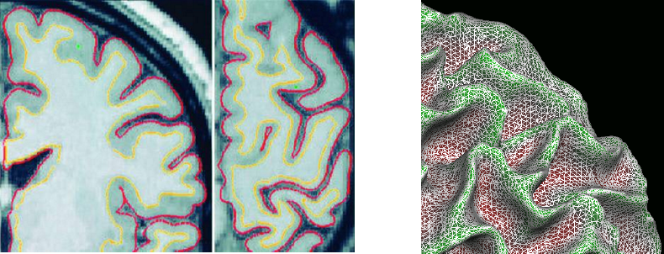
Study cohort
 | Healthy | AD
N | 401 | 238
Age (years) | 74.45 | 74.72
Sex (% females) | 49 | 45
MMSE | 29.1 | 23.2
Apoe4 (% 0/1/2) | 72/26/2 | 31/48/21
adni.loni.usc.edu
B. Gutman Paul M. Thompson
Phenotype features
Freesurfer brain cortical thickness maps (327,684 mesh points)
Radial distance of hippocampi and amygdalae (27,120 mesh points) [Gutman et al, NeuroImage 2013]
Genotype features
Individuals' minor allele counts for 1,167,126 SNPs in chromosomes 1 to 22
Standard quality control: MAF < 0.01, Genotype Call Rate <95% , Hardy-Weinberg Equilibrium < 1x10^{-6.}
Imputation to HapMap III reference panel, quality controlled (MAF > 0.01 and R-squared > 0.3)
Lorenzi, Altmann, Gutman, Wray, Arber, et al, PNAS, 115 (12), 2018
Notes:
We applied the model to a large ADNI cohort.
We used cortical thickness and radial features of hippocampi and amigdalae as brain phenotype
We considered more than 1 million SNP identified through standard preprocessing and quality control procedures

Slide 55
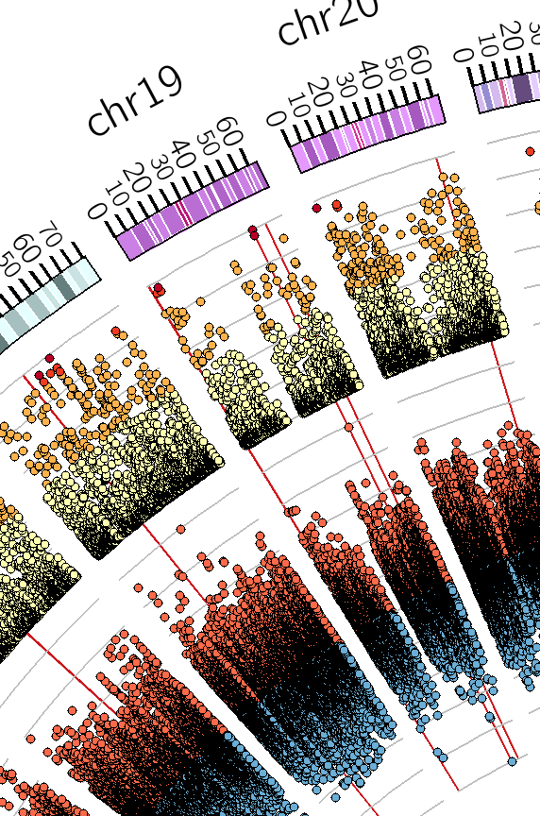




Application to multivariate Imaging-genetics
Genome
Atrophy profile from brain imaging
Partial least squares
association
639 individuals
401 healthy
238 Alzheimer’s
Lorenzi, Altmann, Gutman, Wray, Arber, et al; PNAS, 115 (12), 2018
Notes:
En s’appuyant sur des methodologies similaires, on aussi demontré comme obtenir une representation conjointe de l’atrophie du cerveau, et des variation genetiques sur le genome entiere.
Grace aux regions genomiques associées au profile pathologique du cerveu, on est arrivés a cibler un gene, TRIB3, prometteur pour expliquer certains mechanisms de la pathologie liés a la morte neuronale et a la production de la proteine amyloide.

Slide 56

Investigating biological mechanisms
through Meta-analysis
PLS statistical result
chromosome N
p relevant
locus
proximal areas (+/- 5kbp)
Analysis
of genomic areas
Lorenzi, Altmann, Gutman, Wray, Arber, et al, PNAS, 115 (12), 2018
Notes:
In this way we obtain a vector of probabilities of the relevant genetic locations.

Slide 57


Investigating biological mechanisms
through Meta-analysis
PLS statistical result
chromosome N
Querying gene annotation databases
p relevant
locus
proximal areas (+/- 5kbp)
Analysis
of genomic areas
McLaren et al. The Ensembl Variant Effect Predictor. Genome Biology, 2016
Lorenzi, Altmann, Gutman, Wray, Arber, et al, PNAS, 115 (12), 2018
Notes:
We can look at the genes proximal to the loci of maximal probability and enrich the obtained gene list:
either by looking to known protein protein interactions, or by querying ontologies of known biological and molecular pathways to identify significant biological functions associated to the gene list

Slide 58
Latent variable models
1. Multi-variate modeling
2. Novel scalable approaches to multi-view data
Notes:
It is within this context that I develop my research project, especially the most recent one, that I will illustrate in this talk.

Slide 59

Latent variable models via Variational Autoencoders
Kingma &Welling, 2014; Rezende et al. 2014
Posterior
Likelihood
Difficult to compute
Idea: find a “close enough” and simple approximation

Slide 60
Latent variable models via Variational Autoencoders
Kingma &Welling, 2014; Rezende et al. 2014
=
C. M. Bishop, Pattern Recognition and Machine Learning, Ch.10, Ed. 2006

Slide 61
Latent variable models via Variational Autoencoders
Kingma &Welling, 2014; Rezende et al. 2014
=
Evidence lower bound (ELBO)
reconstruction
regularization
C. M. Bishop, Pattern Recognition and Machine Learning, Ch.10, Ed. 2006

Slide 62




Generative representation of multimodal data
Antelmi, Ayache, Robert and Lorenzi, ICML 2019
Notes:
Pour etablir un lien entre donnees complexes et heterogenes, en statistique on peut s’appuyer sur ce que on appel modeles a “variables latents”.
Dans ce modeles, on fait l’hypothese que les donnees que on observe pour un patient sont issus de un variable latent associée a l’etat latent du patient.
En termes statistiques, on donne une probabilité aux donnees, en sachent l’etat latent, et on cherche de estimer la relation plus plausibles entre ces variables, qui on appelle “decodage”

Slide 63

Generative representation of multimodal data
Decoding
Patient’s latent
status
?
Decoding: data reconstruction from the latent representation
Antelmi, Ayache, Robert and Lorenzi, ICML 2019
Notes:
Pour etablir un lien entre donnees complexes et heterogenes, en statistique on peut s’appuyer sur ce que on appel modeles a “variables latents”.
Dans ce modeles, on fait l’hypothese que les donnees que on observe pour un patient sont issus de un variable latent associée a l’etat latent du patient.
En termes statistiques, on donne une probabilité aux donnees, en sachent l’etat latent, et on cherche de estimer la relation plus plausibles entre ces variables, qui on appelle “decodage”

Slide 64
Generative representation of multimodal data
Encoding
Decoding
Patient’s latent
status
Decoding: data reconstruction from the latent representation
Encoding: latent representation from the data
Antelmi, Ayache, Robert and Lorenzi, ICML 2019
Notes:
Une facon de estimer cet etat latent, est de le faire directement a partir des donnees, ou par l’ ”encodage”.
Pour example on pourrait estimer la distribution de l’etat latent a partir des donnees de imagerie structurelle.

Slide 65
Generative representation of multimodal data
Encoding
Decoding
Patient’s latent
status
Decoding: data reconstruction from the latent representation
Encoding: latent representation from the data
Antelmi, Ayache, Robert and Lorenzi, ICML 2019
Notes:
Ou meme des autres types des donnees.

Slide 66
Generative representation of multimodal data
Encoding
Decoding
Patient’s latent
status
Decoding: data reconstruction from the latent representation
Encoding: latent representation from the data
Antelmi, Ayache, Robert and Lorenzi, ICML 2019

Slide 67
Generative representation of multimodal data
Encoding
Decoding
Patient’s latent
status
Decoding: data reconstruction from the latent representation
Encoding: latent representation from the data
Antelmi, Ayache, Robert and Lorenzi, ICML 2019
Notes:
Pour obtenir representation differents , chaque une issue de une vision differente du patient.

Slide 68

Generative representation of multimodal data
Encoding
Decoding
Patient’s latent
status
Decoding: data reconstruction from the latent representation
Encoding: latent representation from the data
Antelmi, Ayache, Robert and Lorenzi, ICML 2019
Notes:
En pratique, on voudrait ces representations etre les plus proches possibles a une representation cible, ca veut dir la posteriori de l’etat latent en sachent les donnees.

Slide 69

Generative representation of multimodal data
minimize
Antelmi, Ayache, Robert and Lorenzi, ICML 2019
Notes:
On peut formuler cette hypothese avec une critere qui s’appuye sur la minimisation de la distance entre ces representations latents differentes.

Slide 70

Generative representation of multimodal data
Evidence Lower bound (ELBO)
minimize
Antelmi, Ayache, Robert and Lorenzi, ICML 2019
Notes:
Et montrer que l’optimisation de ce probleme amene a ce genre de functionnel dans lequel on

Slide 71
Generative representation of multimodal data
Evidence Lower bound (ELBO)
Encoding for given channel
minimize
Antelmi, Ayache, Robert and Lorenzi, ICML 2019
Notes:
cherche la meilleure representation latent a partir de un certain type des donnees,

Slide 72
Generative representation of multimodal data
Evidence Lower bound (ELBO)
Encoding for given channel
Reconstruction of all channels
minimize
Antelmi, Ayache, Robert and Lorenzi, ICML 2019
Notes:
Et on demande que nous permets de recontruir tout les autres donnees par le decodeur.

Slide 73
Generative representation of multimodal data
Evidence Lower bound (ELBO)
Encoding for given channel
Reconstruction of all channels
Regularization: sparsity inducing prior
minimize
[Kingma et al, NIPS, 2015; Molchanov et al, ICML 2017]
Antelmi, Ayache, Robert and Lorenzi, ICML 2019
Notes:
En plus, on obtient un terme de regularisation qui oblige chaque representation a etre proche a une cible apriori, dans lequel on impose un contraint de parsimonie.

Slide 74

Classic Implementation (non sparse)
Evidence Lower bound (ELBO)
Reconstructions:
Encodings:
Prior:
Antelmi, Ayache, Robert and Lorenzi, ICML 2019
Notes:
En plus, on obtient un terme de regularisation qui oblige chaque representation a etre proche a une cible apriori, dans lequel on impose un contraint de parsimonie.

Slide 75

Sparse Implementation
Evidence Lower bound (ELBO)
Reconstructions:
Encodings:
Prior:
Antelmi, Ayache, Robert and Lorenzi, ICML 2019
Notes:
En plus, on obtient un terme de regularisation qui oblige chaque representation a etre proche a une cible apriori, dans lequel on impose un contraint de parsimonie.

Slide 76



Sparse Implementation: why it works?
Evidence Lower bound (ELBO)
Encodings:
Prior:
Relationship between α and the probability of pruning the i-th dimension:
Prior and encodings act together such that (element-wise):
Antelmi, Ayache, Robert and Lorenzi, ICML 2019
Notes:
En plus, on obtient un terme de regularisation qui oblige chaque representation a etre proche a une cible apriori, dans lequel on impose un contraint de parsimonie.

Slide 77



Prediction from latent space
training
testing
Joint modeling of
- Brain imaging:
Structural (T1 MRI)
Molecular (FDG-PET + Amy-PET)
- Socio-demographic factors
- Clinical scores
Accuracy (SD)
Antelmi, Ayache, Robert and Lorenzi, ICML 2019
Notes:
Et ici on voit la representation latent que on obtient quand on optimise le modele sur des donnees reels.
On peut noter que meme si le modele est agnostique de la diagnostique, on arrive a obtenir une representation latente qui est fortemente associée aux different etats cliniques de la maladie, et qui amene a une tres bonne differentiation entre groups cliniques. Cette representation est consistente soit dans les donnees de entreinement, soit dans les donnees de validation

Slide 78





Generation from latent space
healthy
Atrophy abnormality (MRI)
Metabolism abnormality (FDG)
Amyloid abnormality (AV45)
pathological
Patient’s latent status
from cognitive scores only
Improved interpretability
Multi-channel: working with missing data/data imputation
Simulations for clinical trials
Antelmi, Ayache, Robert and Lorenzi, ICML 2019
Notes:
En plus, grace a la formulation generative du modele, on peut genere des cartes de pathologie associées au etat latent.
Cette proprieté est tres interessante pour interpreter le modele, et pour l’exploration de la variabilitée associé aux donees, pour example pour simuler des jeux des donnees pour des essays cliniques.

Slide 79
Thank you
Notes:
explicitly highlight the underlying biology of macroscopic processes, such as brain atrophy, by identifying interacting sets of genes that are jointly associated with the phenotype. Multivariate GWA studies offer the potential to shed light on the complex genotype-phenotype relationship, and may thus highlight novel links between brain physiology and biological as well as molecular functions.

